Slide 1
WEB FRAMEWORKS PROJECT
MUSIC BLOG : SOUND SHARP USING DJANGO AND REACT
Group Members:
1. Ashika Meryl Pinto
2. Rachana Sudhindra Dani

Slide 2
Website description:
Sound Sharp is a music blog we have created, that has a react front end and a Django backend in which the creator upload music files, normally in the MP3 format(or other), available for listen and download. He/she is allowed to edit his posts in the website, also delete them if she doesn’t want them to appear in the blog any longer.
We also have a comment section for each Music post where all comments received for that particular song will be displayed.The user is also allowed to delete these comments to stop them from appearing on the blog. Here we provide an option to ‘add comments’ where the user can type in his opinion about the song.
Both song posts and comments are stored in the database.Any edit/delete/add changes in the react frontend are being reflected in the Django database.

Slide 3
Individual contribution of each team member
Equal contribution in all phases of the project.
We worked together throughout.

Slide 4
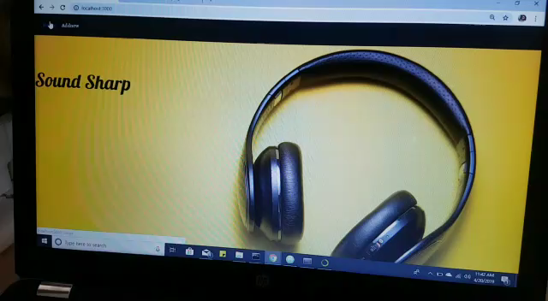
Video:

Slide 5
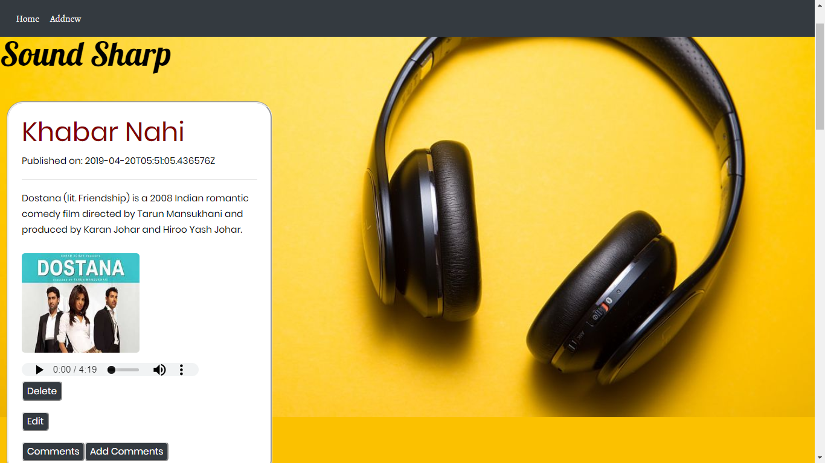
Screenshots:

Slide 6
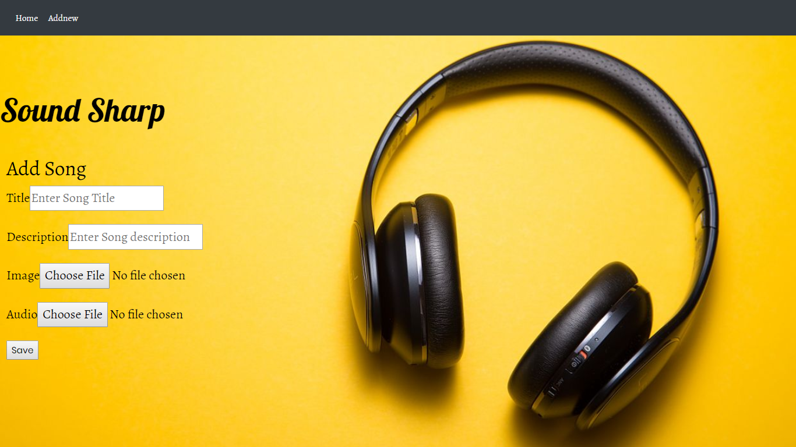

Slide 7
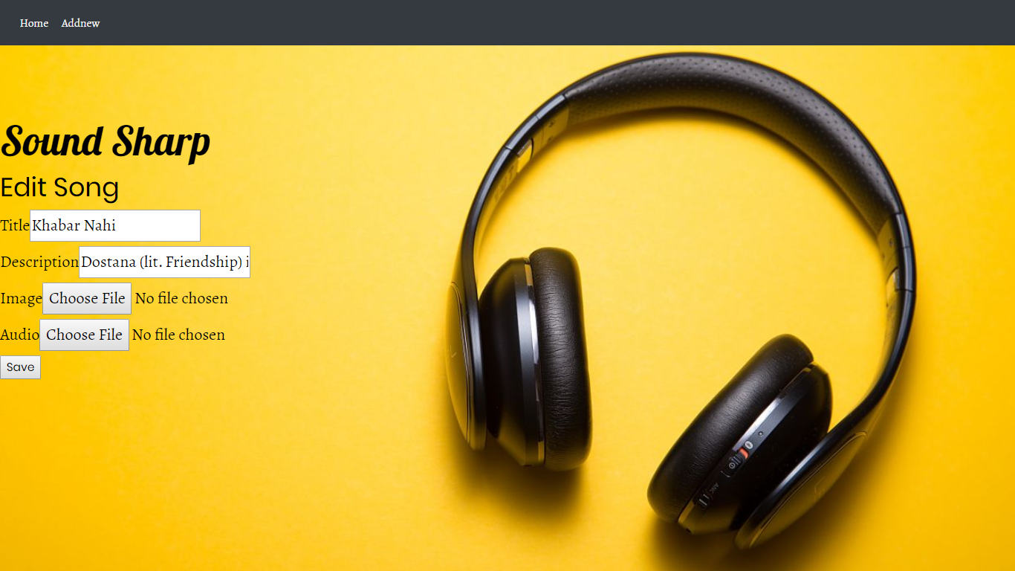

Slide 8
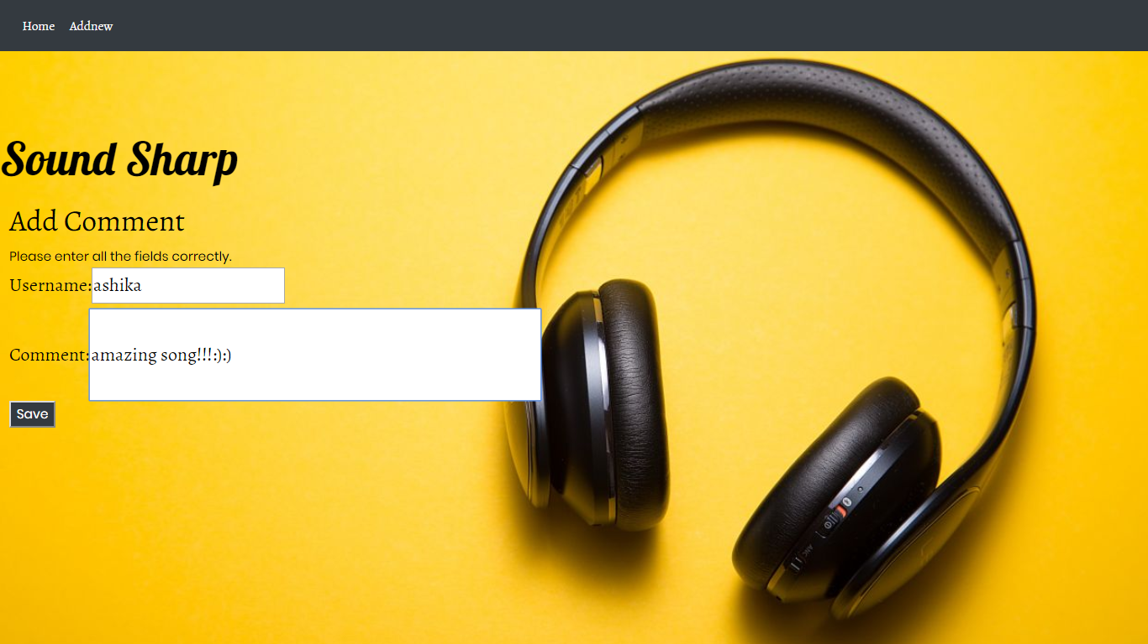
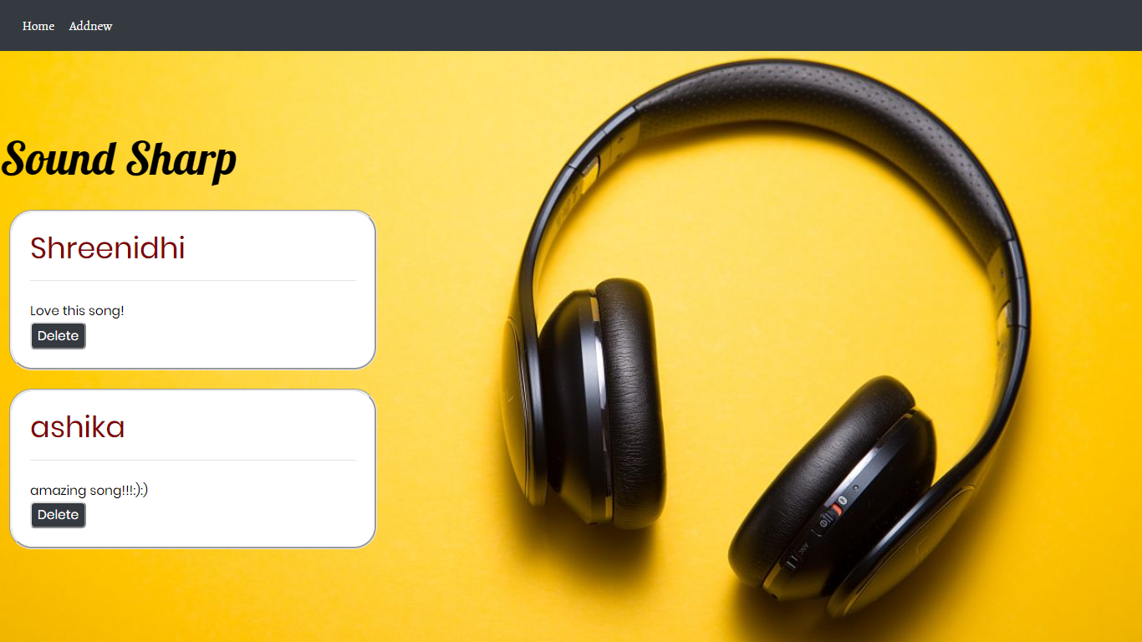

Slide 9
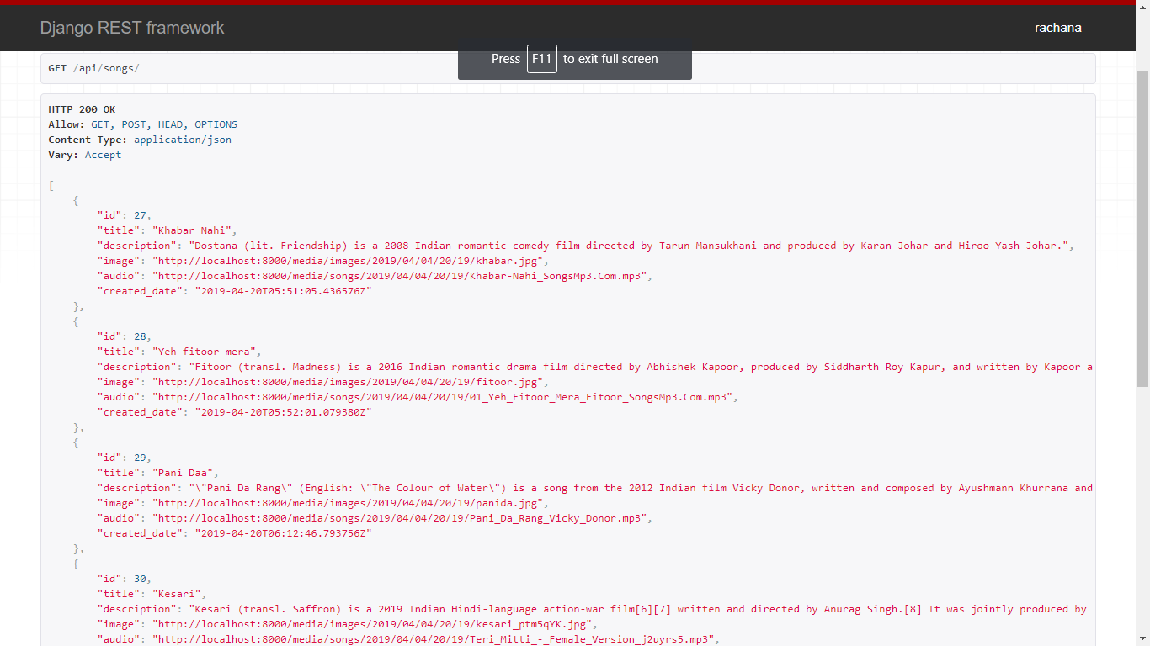

Slide 10
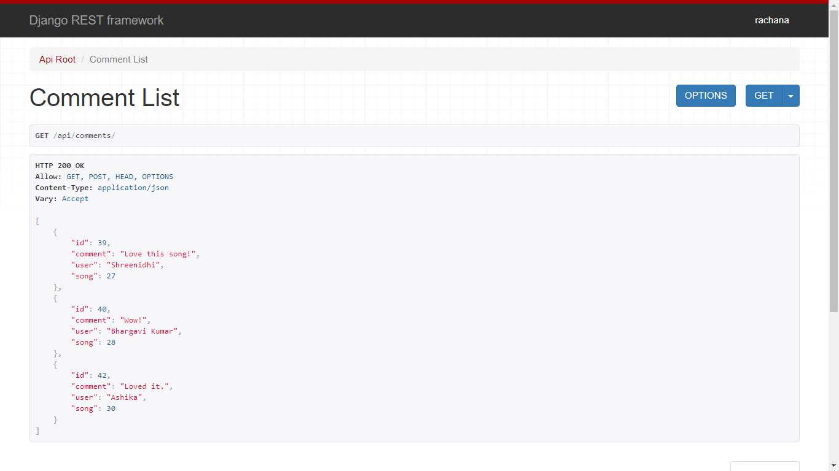

Slide 11
Takeaways:
Learnt how to build a web app using Django backend and react frontend.
Learnt how to use axios to send POST,GET, DELETE and PUT requests from react to Django.
Learnt how to use components in react efficiently
Learnt how to define functions in react and pass parameters to them
Learnt how to define state variable correctly
Figured out what exactly should be sent through FormData while sending requests through axios
Learnt how to use router library of react for linking or redirecting to routes

Slide 12
Learnt the usage of slugs for creating more meaningful URL’s
Learnt the usage of Django sessions

Slide 13
Challenges:
Learning the exact usage and functions of axios
Figured out what exactly should be sent through FormData while sending requests through axios
Handling various pages and their navigation for different sections of our website and making sure that it is a single page application.
Handling navigation in React: Lead to proper learning of the router library of react.
Displaying and storing image and audio fields in react front end from and into the Django database.

Slide 14
Figuring out how to solve the axios post error on submitting form with Image and Audio type fields.-→
This error occurred because axios POST method was sending strings to Audio and Image Fields.We were assigning state variables for image and audio with e.target.value. But when we replaced it with e.target.files[0] , the POST method worked successfully.(files[0] takes care that only one file is uploaded, value would give a string)
We also cleared the 404 Bad request Error by adding a header with ContentType:’multiport/FormData’ without which submitting files wasn’t possible.

Slide 15
Figuring out how to retrieve the values stored in Django sessions in React. Due to minimal resources found for this,we made a simple front end in Django only to display the usage of sessions in login.
Figuring out how to encorporate slugs in React(as we are using routers for navigation). Again due to minimal resources, we could do it only in Django.

Slide 16
Sources referred for getting clarity in axios:
https://www.youtube.com/watch?v=XeiOnkEI7XI

Slide 17
Contact Info
1.RACHANA SUDHINDRA DANI
USN: PES1201700950
rachnadani.rd@gmail.com
2.ASHIKA MERYL PINTO
USN: PES1201701346
pintoashika@gmail.com

